Slide 1
Ionospheric Studies Task Force (ISTF/4) Meeting
PHILIPPINES
UPDATE FOR TASK 1
(Data Collection)
February 5-7, 2014
New Delhi, India

Slide 2
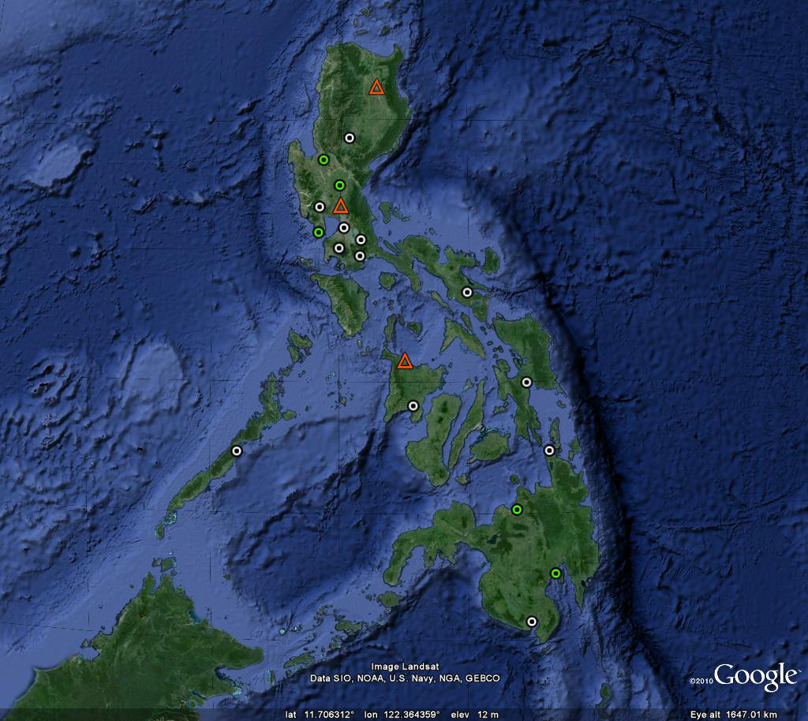
Update on Data Sources
Currently Operating AGS
Total = 17 Stations
Iono Delay Data Sources =
12 (Leica GRX1200)
5 (Trimble Net R9)
Possible Scintillation Data Sources = 5
Each AGS are currently configured to log at 1Hz, and the data are sent every hour to the main server for archiving (24 separate data files per day per site) .
No data available yet for scintillation analysis since all AGS are configured to log at 1 Hz.
Out of the 6 planned new sites in 2013, 3 sites are already procured and are for installation.
- iono delay data sources
- iono & scintillation data sources
- procured and for installation
*source: National Mapping and Resource Information Agency (NAMRIA), Philippines

Slide 3
Update on MOA
On Use of NAMRIA data within CAAP:
MOA between CAAP and NAMRIA on the sharing of NAMRIA data for use within CAAP has already been approved.
The MOA included the agreement to install a new NAMRIA AGS site (PDAV) within the Davao International Airport.
Use of NAMRIA data within ISTF:
MOA between CAAP and NAMRIA on the sharing of NAMRIA data for use within the ISTF is currently under process.
Expected to be completed by Q2-2014.

Slide 4
THANK YOU!

